Slide 1

Fractals and Recursive Functions
Akaash Parthasarathy, Rohan Phadnis, Ansh Bhatti

Slide 2
“Roughness is a part of human life”
- Benoit Mandelbrot

Slide 3
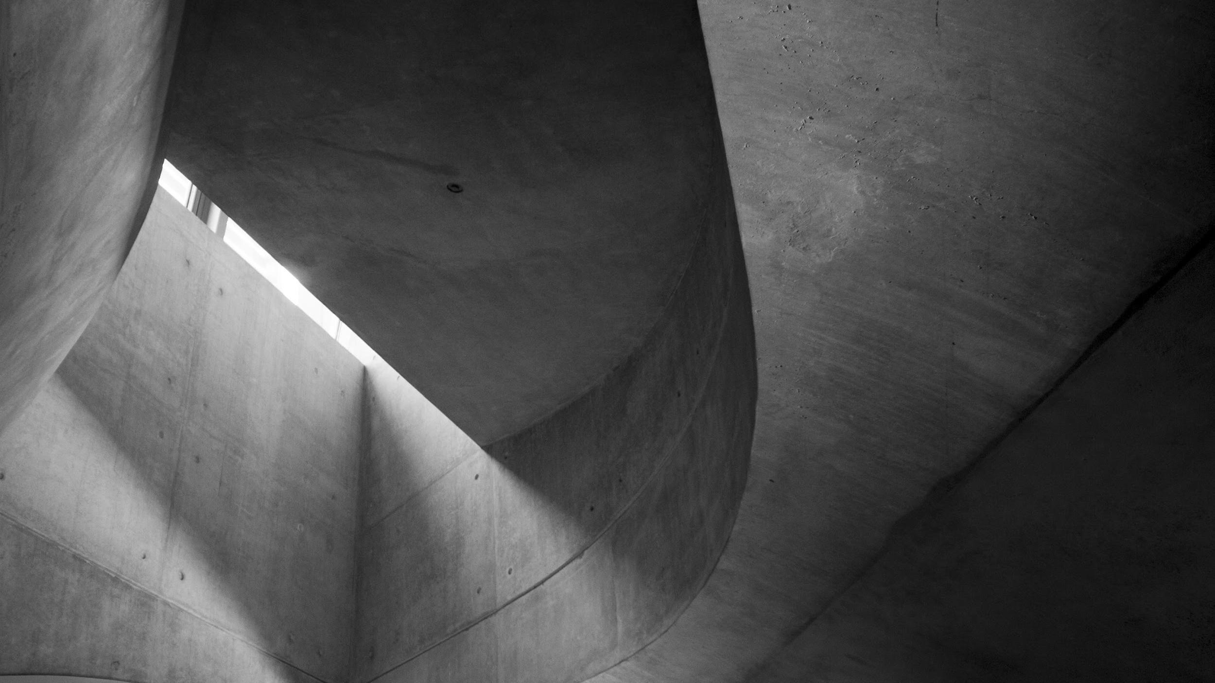
The Mathematics of Fractals

Slide 4
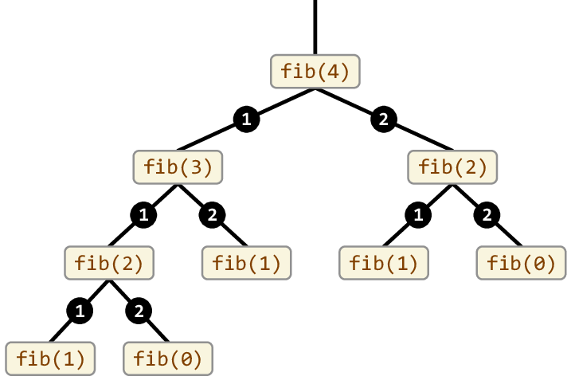
Recursion
A mathematical definition
Invokes itself to break problems into smaller, similar problems
Finite Recursive Functions - base case
Factorial:
Fibonacci:
Infinitely Recursive Functions - no base case; only theoretical

Slide 5
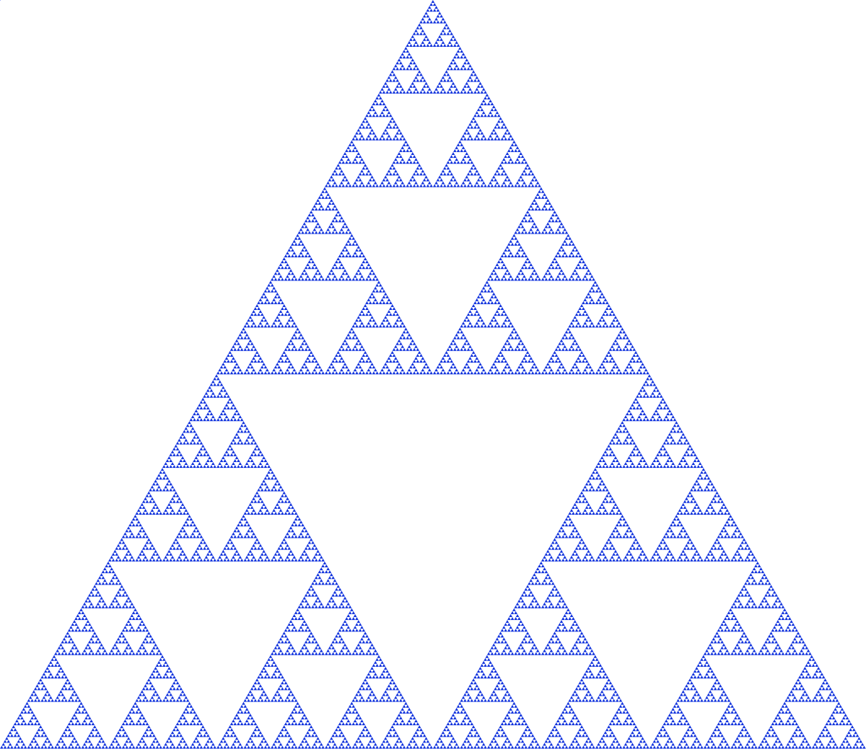
Fractals
A mathematical definition
Infinitely rough geometric shapes
Self-similarity property
Can be generated recursively

Slide 6

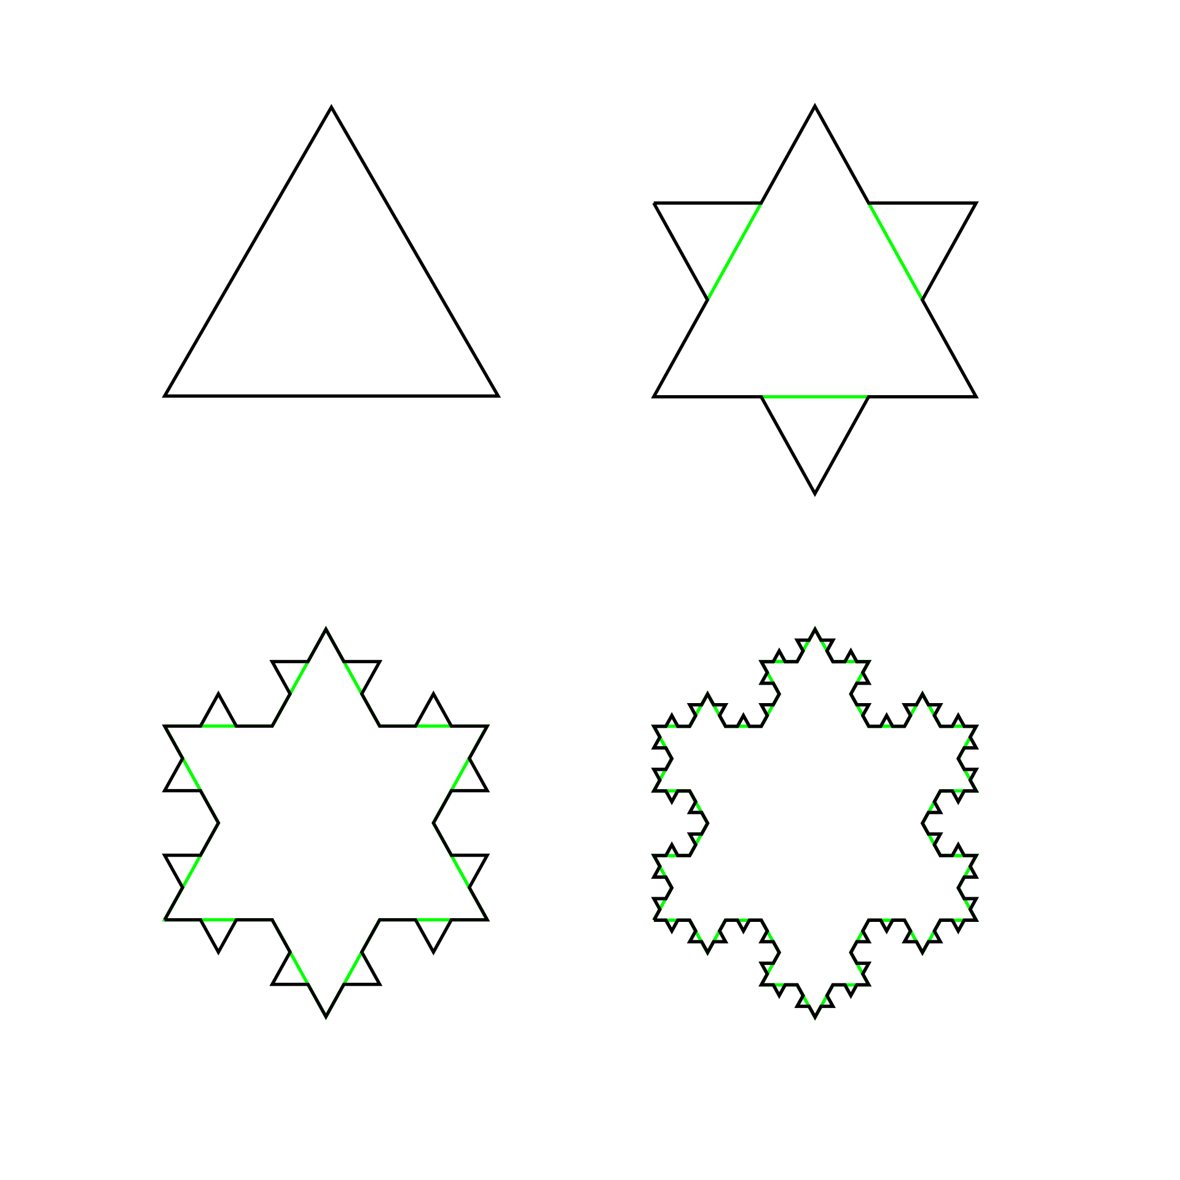
Koch Snowflake
A famous fractal
Generated using equilateral triangles within equilateral triangles

Slide 7
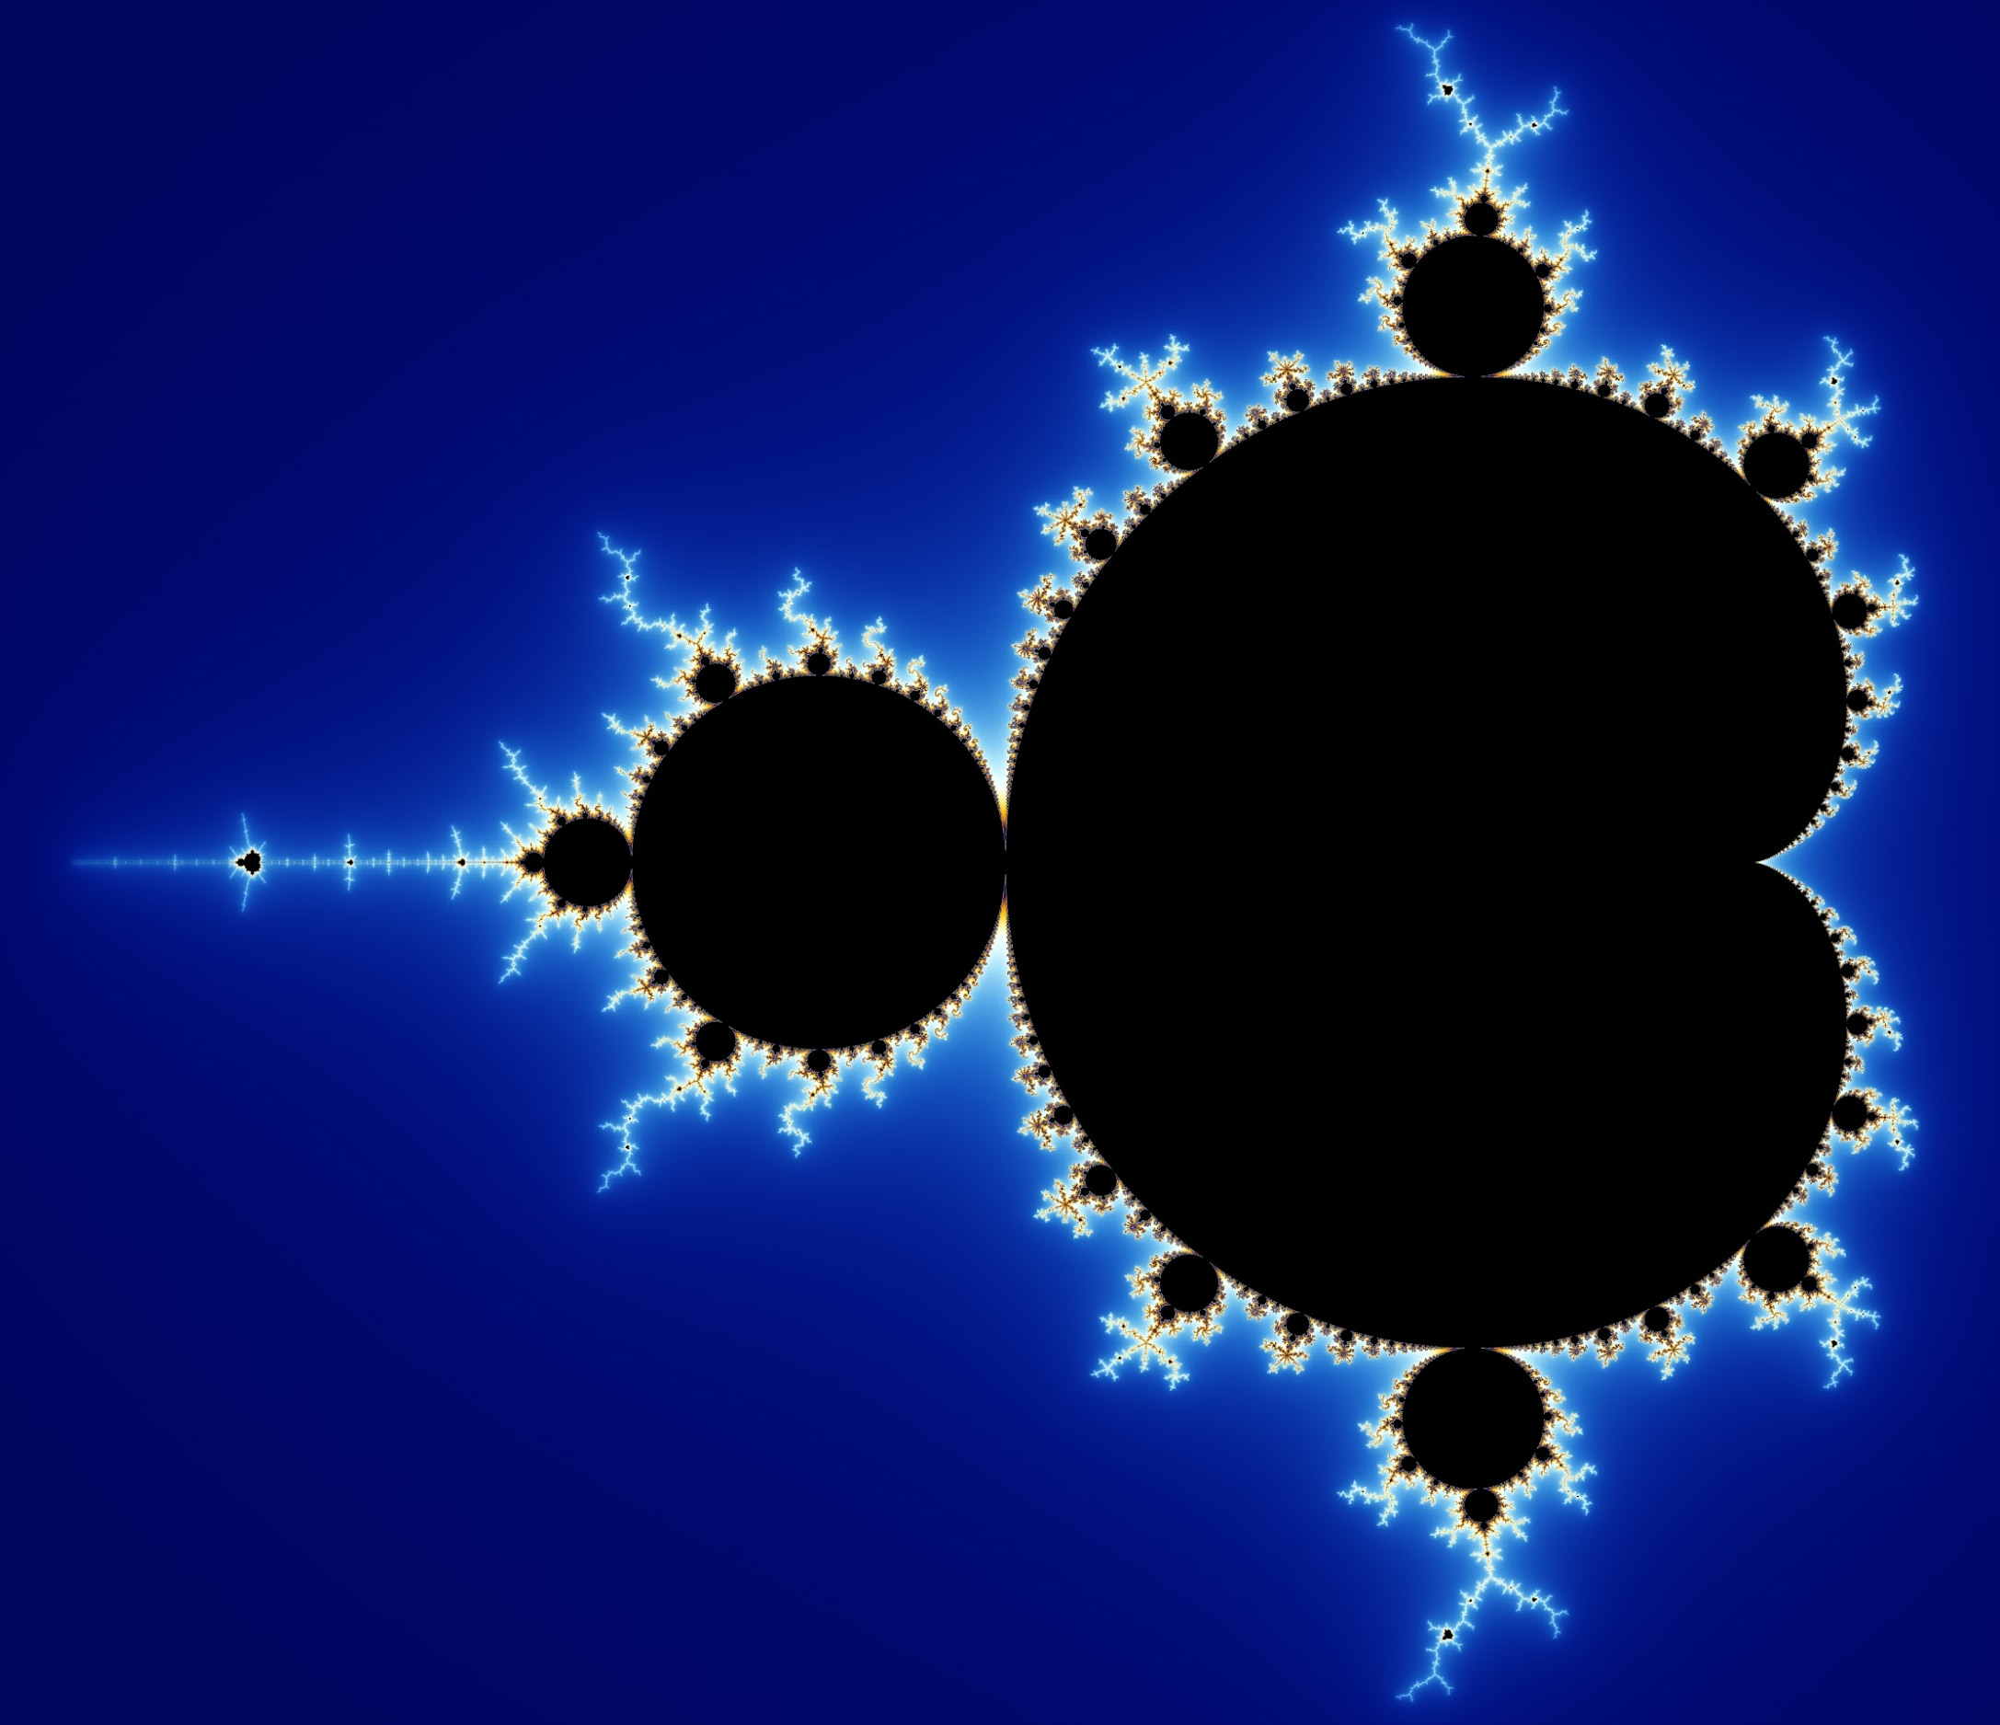
Mandelbrot Set
Another famous fractal
A self-repeating fractal generated using complex numbers
Developed and theorized by Benoit Mandelbrot

Slide 8
Applications of Fractals

Slide 9
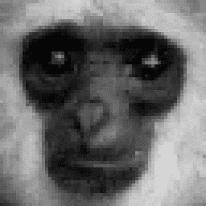
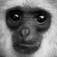

Fractal Image Compression
An application of self-similarity
Images require lots of data
Fractal compression by exploiting self-similarity in images
Restoring original size
Works best for patterns, natural landscape photos
Original
Zoomed-in
Resizing using Fractal Decompression

Slide 10
Fractal Antenna

Slide 11
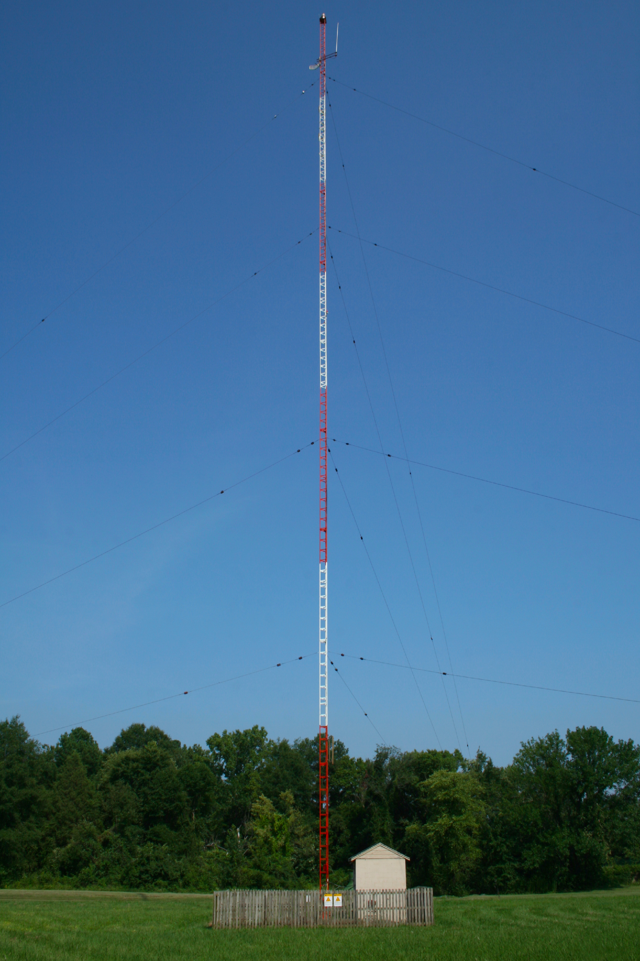
Antenna
Science of antennae explained
Piece of wire
Current’s magnitude and direction alternated
Electromagnetic field generated
Receiver antenna’s current changes

Slide 12
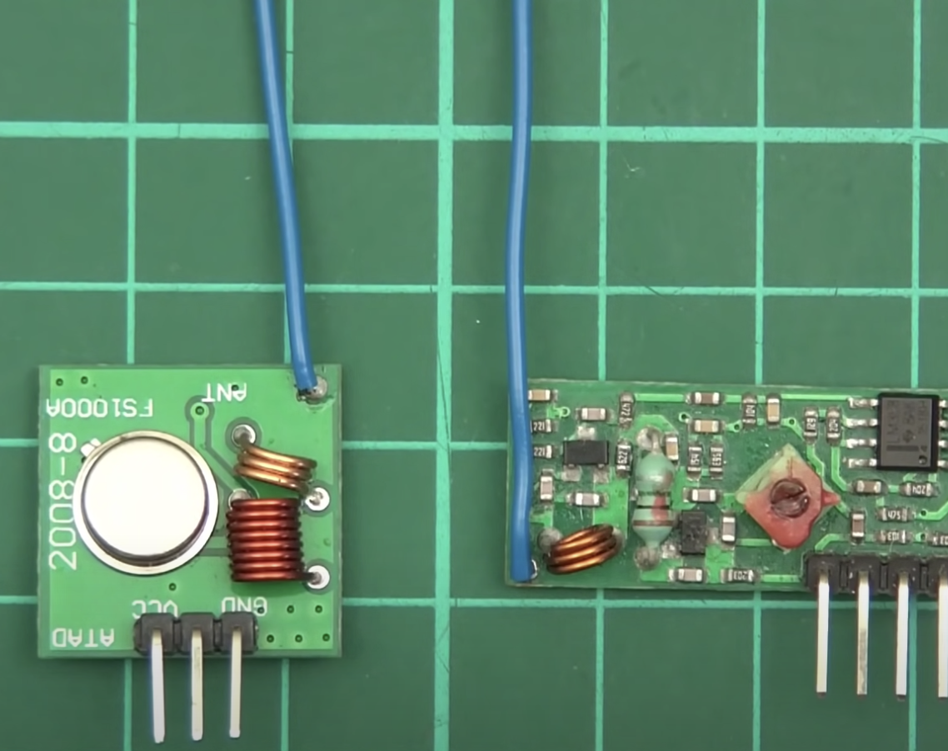
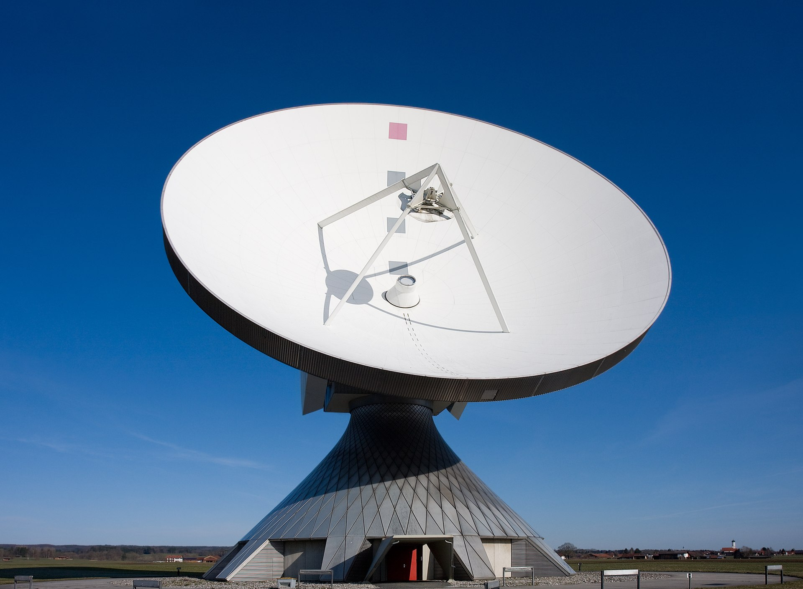
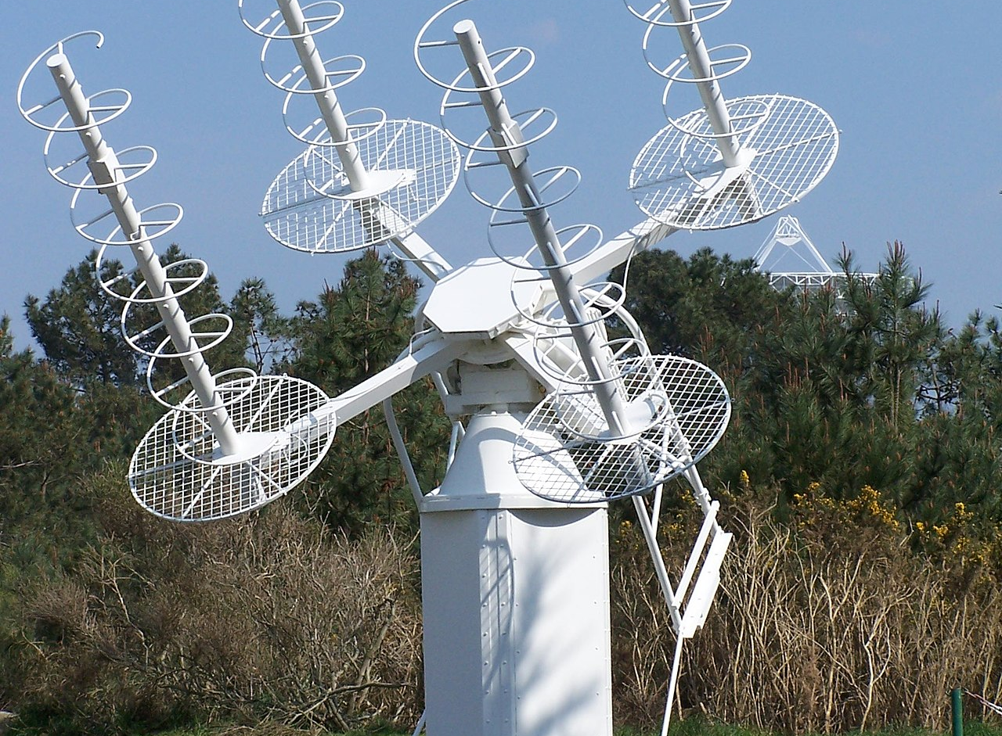

Slide 13
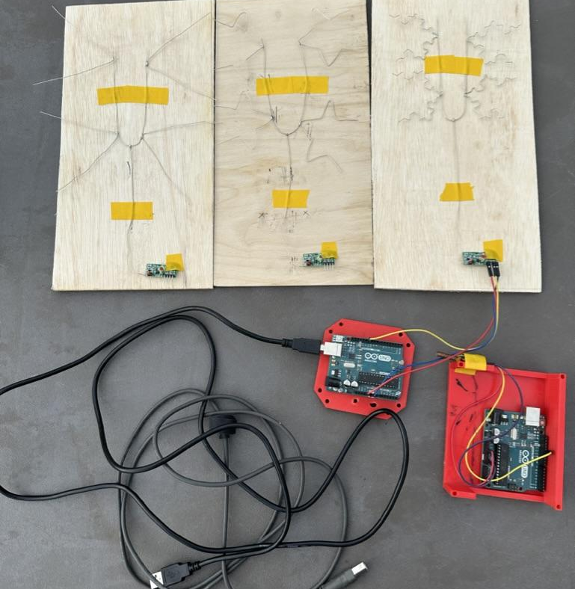
Experiment
Testing fractal antenna range
Build 3 Antenna Setups of 0, 1, and 2 Koch Snowflake iterations
Tested range of each setup

Slide 14
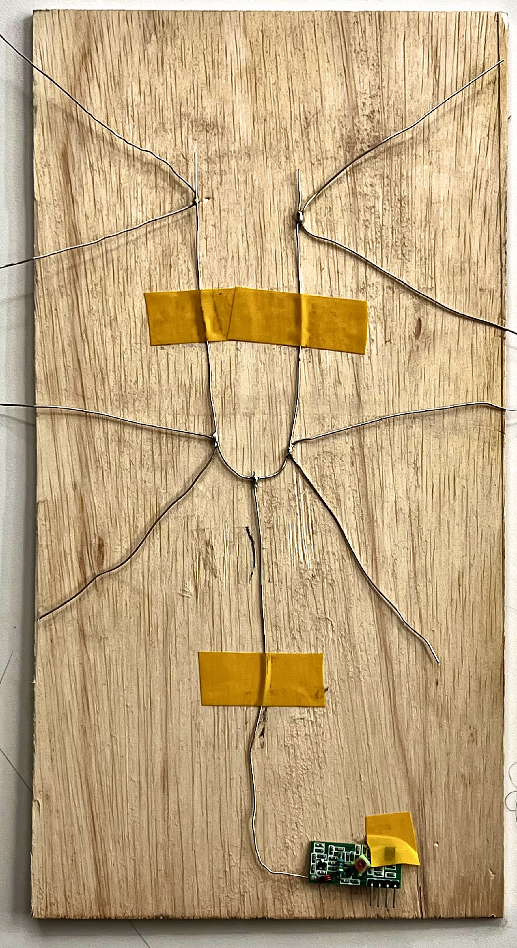
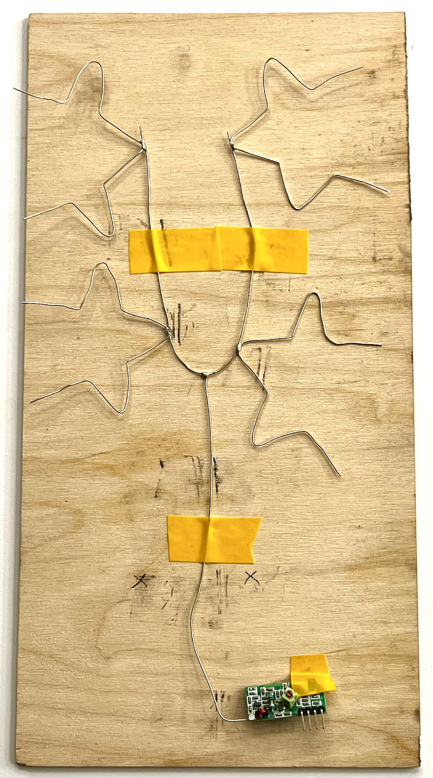
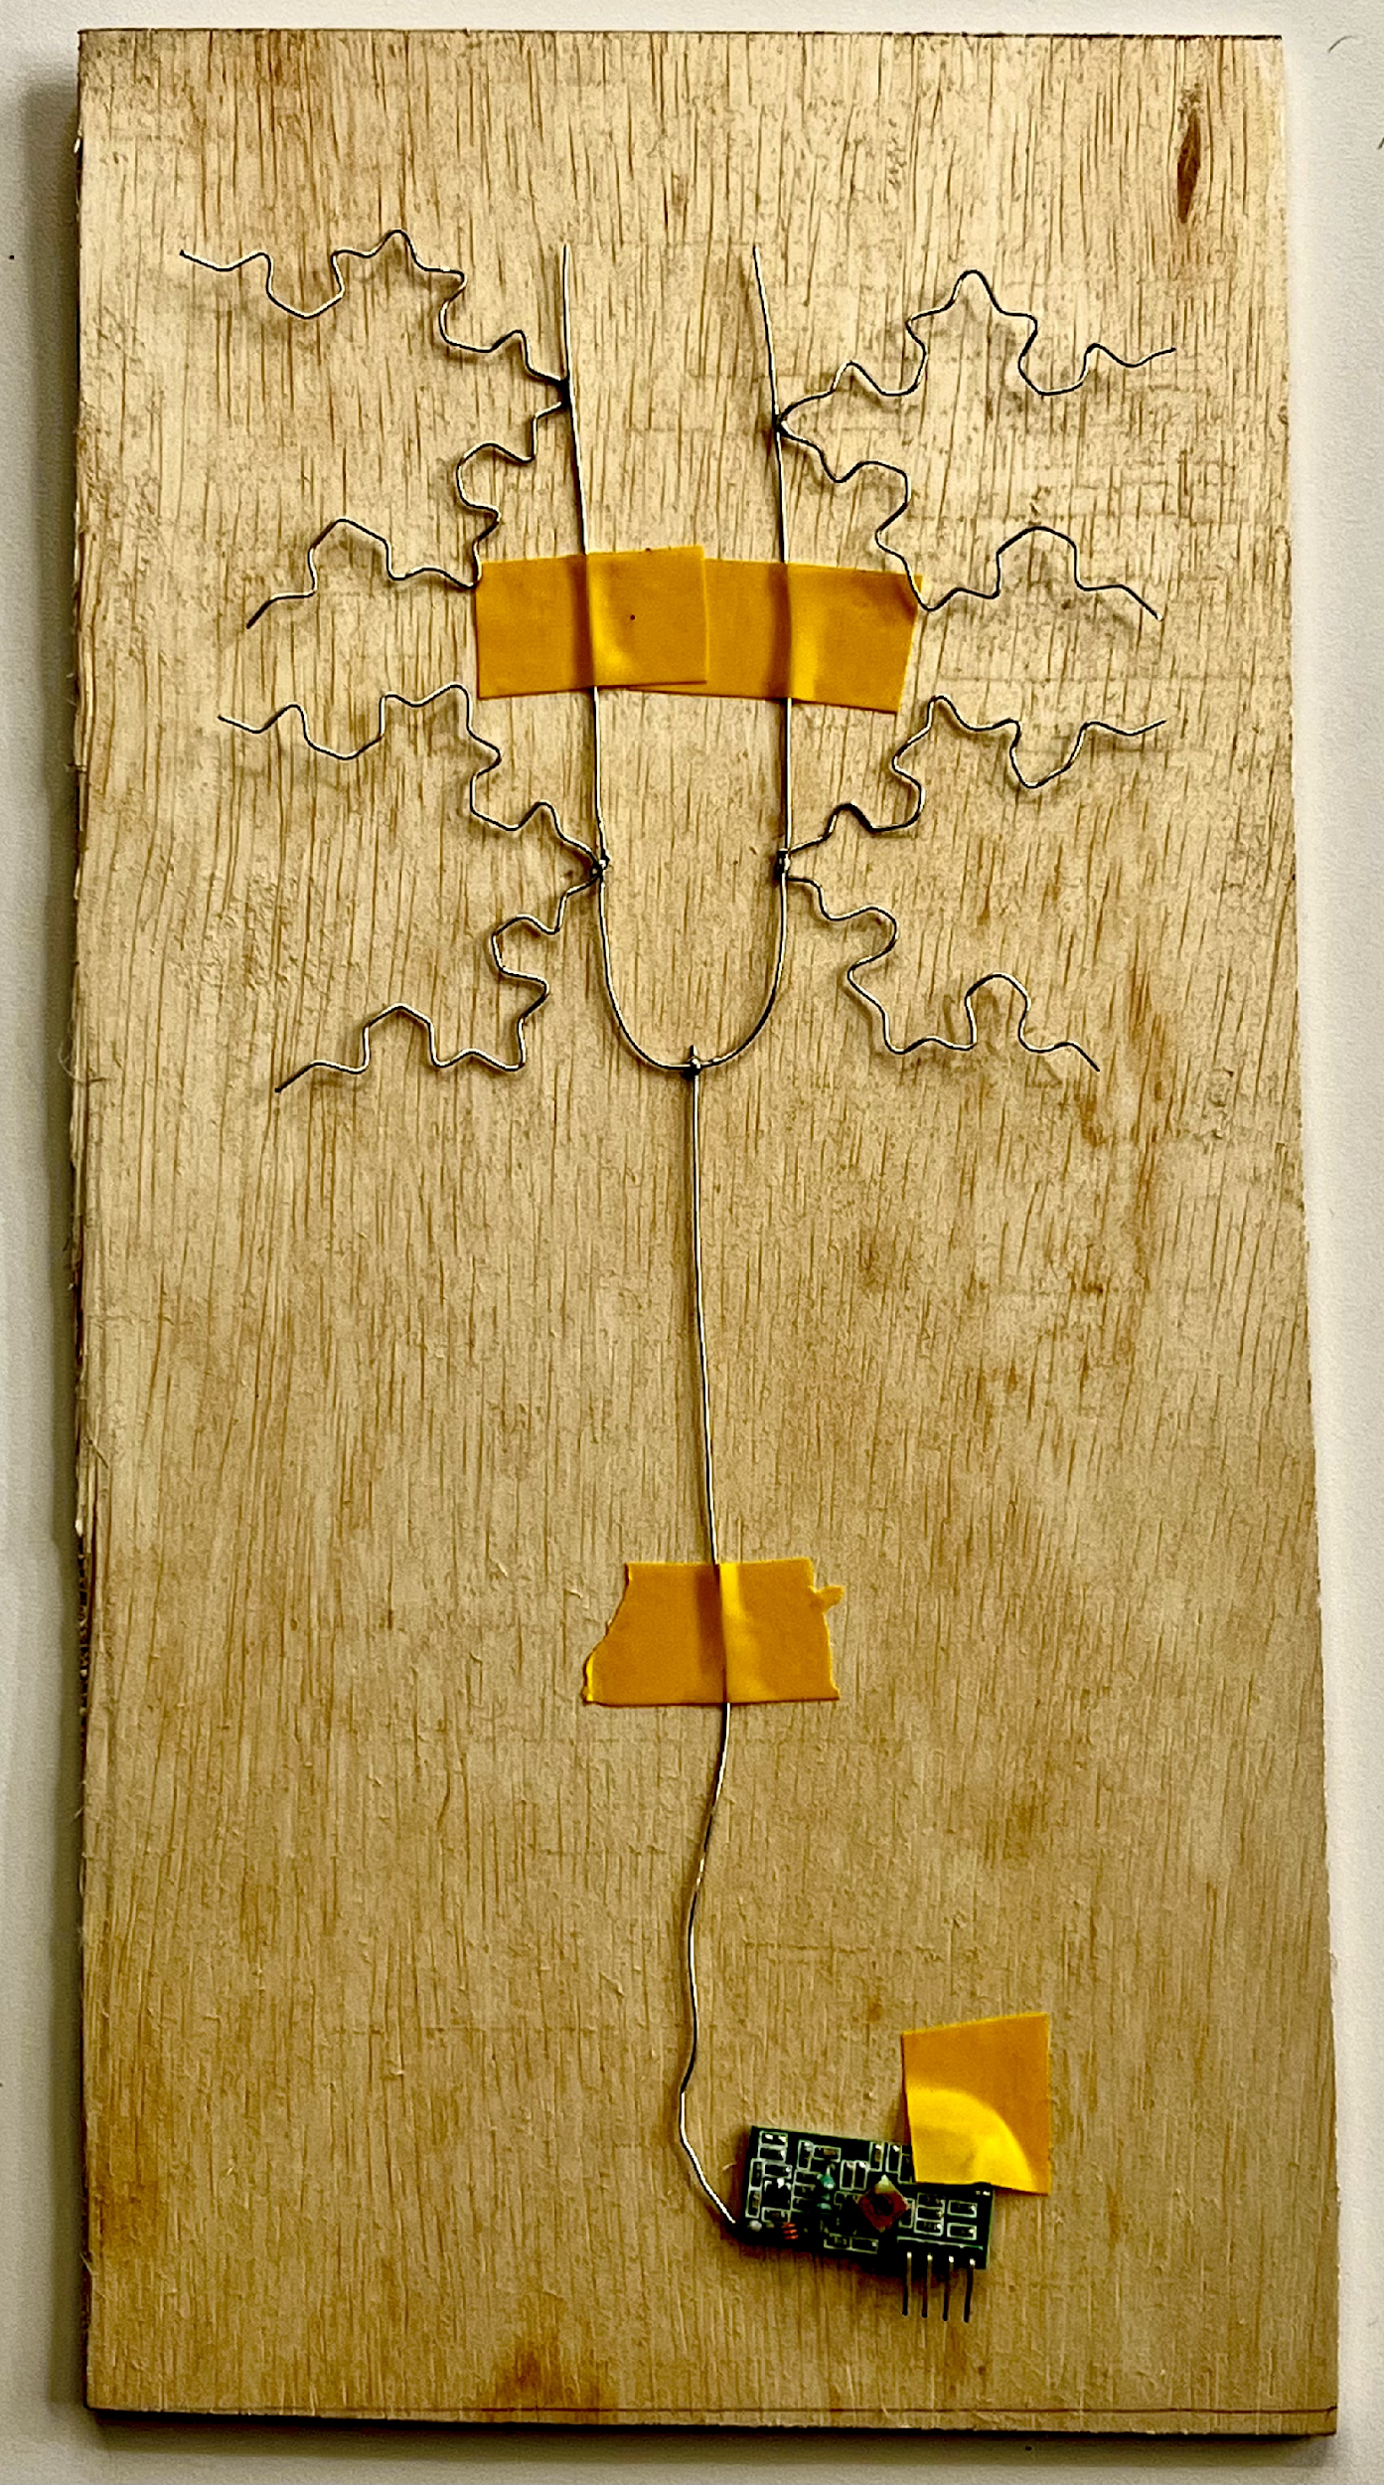
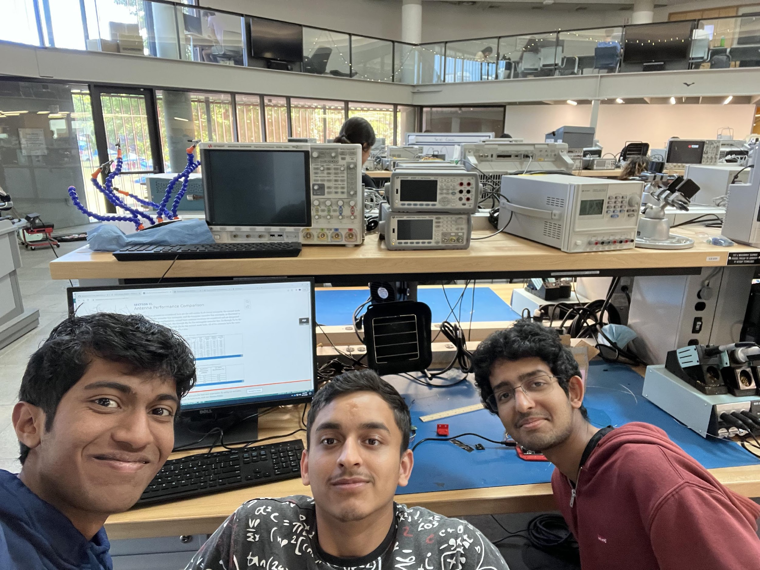
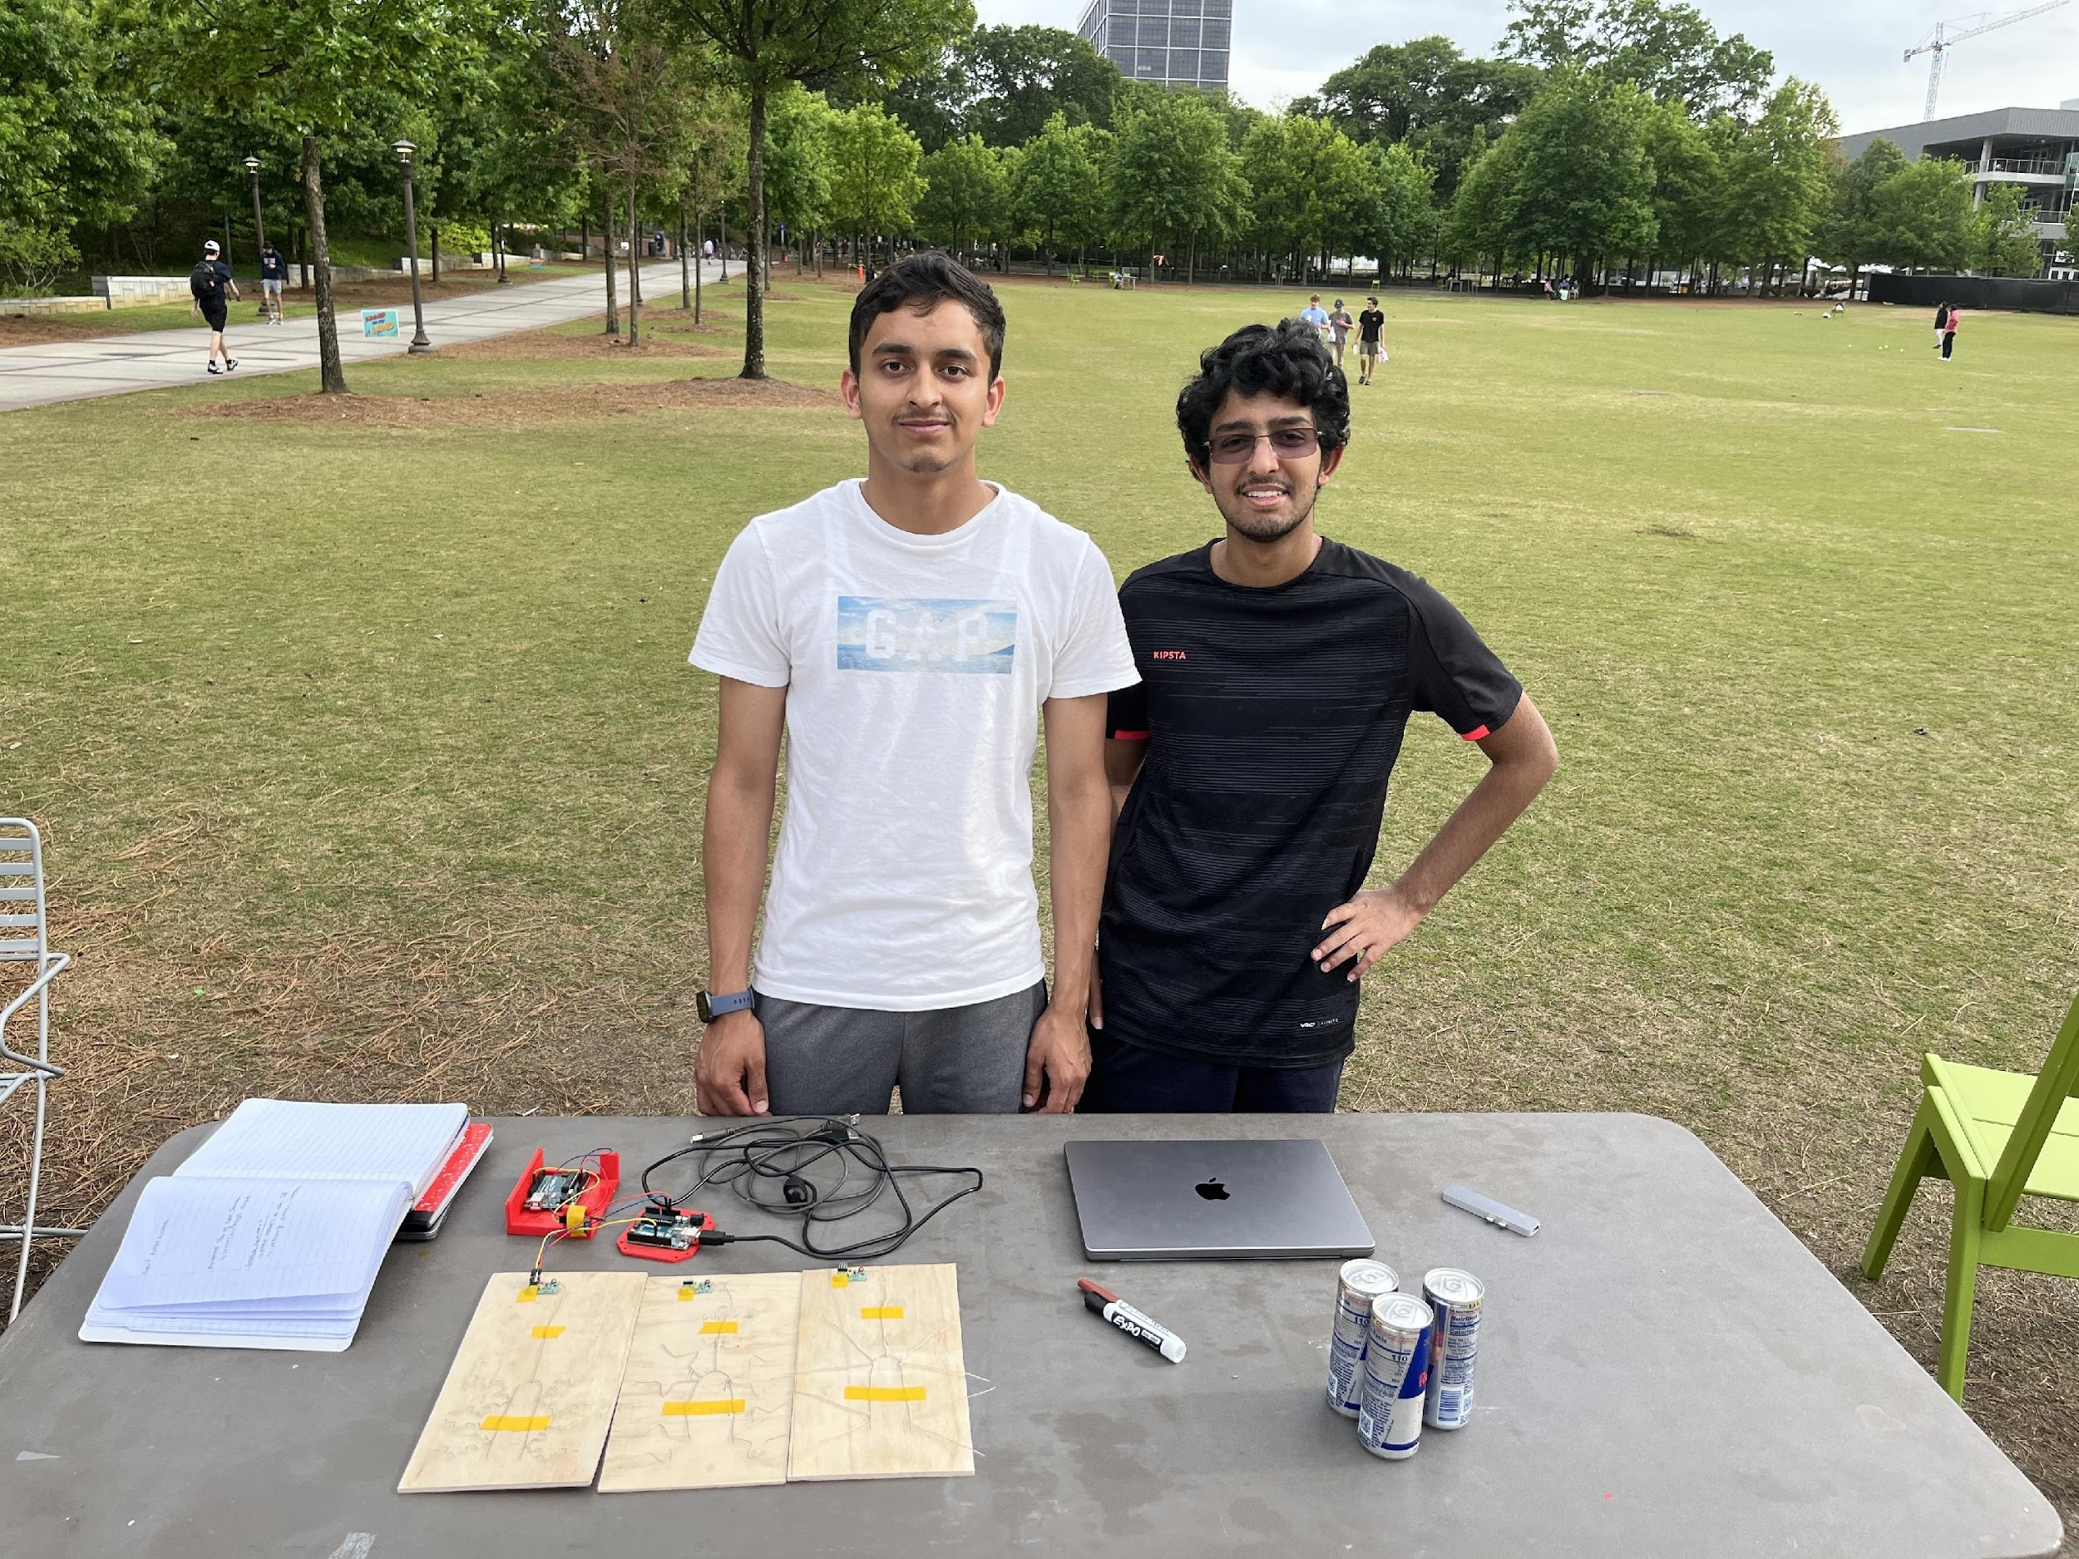
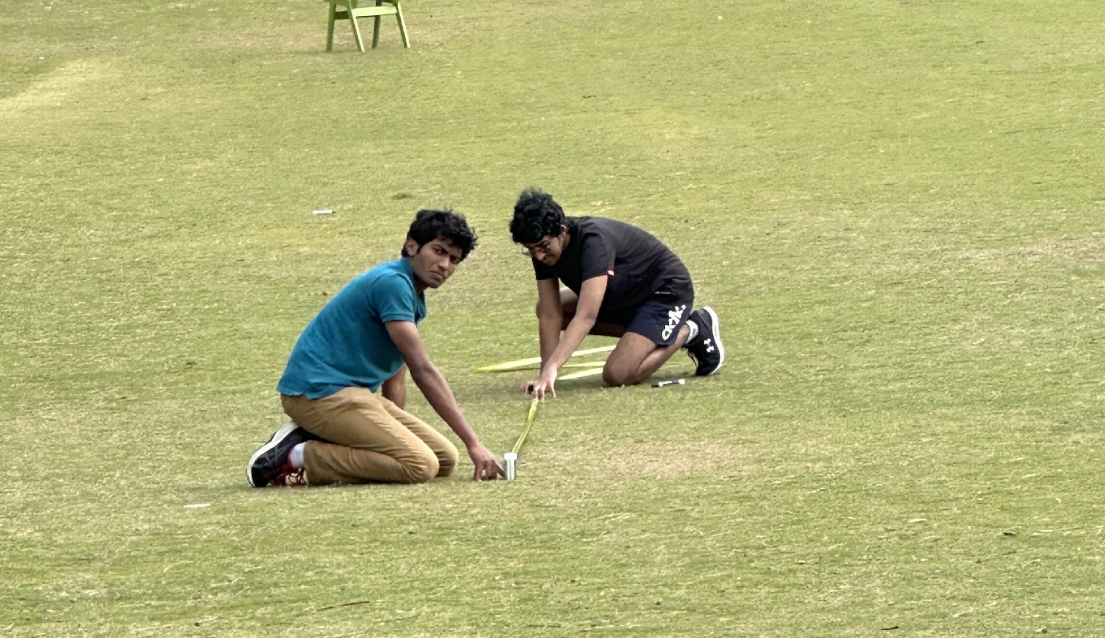

Slide 15
Data
Experimental Data and Key Insights
Fractal Antennae’s geometric shape
Allows more operational frequencies
Increases surface area of antenna
Range, reliability increases
Bottleneck effect prevents widespread implementation
Iteration | Max Range
0 | 18.379m
1 | 25.512m
2 | 36.064m

Slide 16
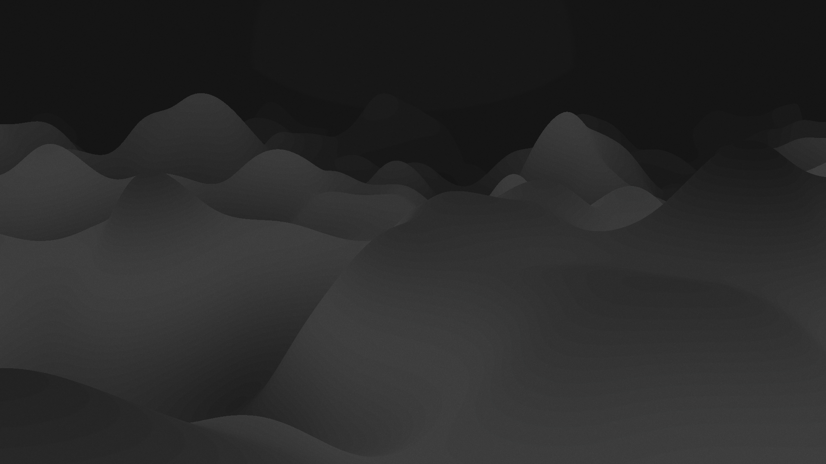
Acknowledgements
Special Thanks To…

Slide 17
Thank You!

